Slide 1

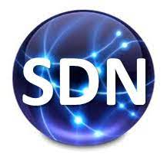
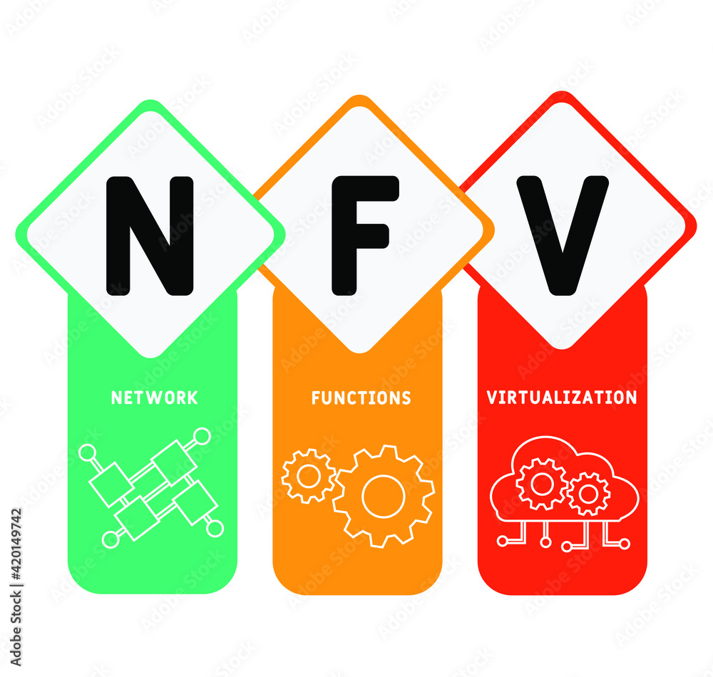



PDS
Computer Vision
CCNA Academic
CCNA 1, 2, 3, 4
@ P. Siagian
https://github.com/siagianp
https://www.youtube.com/@AmelOline/videos
https://github.com/amelcharolinesgn2/IoT_simulator-mqtt-NodeRed
https://github.com/amelcharolinesgn2/Cloud-Infrastructures
https://github.com/amelcharolinesgn2/ClouD-Infrastructure-SISKA-2025
https://github.com/amelcharolinesgn2/Gyroscope-Sensor-Data-Accelerometer
Notes:
Setting Up Ubuntu 20 Server on VirtualBox for Node.js App
https://github.com/NawalAShaltout/OS-02-/tree/main/Lab-03

Slide 2
CCNA
CCNA 1 -
[1] 01_Explore_the_Network
[1] 02_Configure_a_Network_Operating_System
[1] 03_Network_Protocols_and_Communication
[1] 04_Network_Access
[1] 05_Ethernet
[1] 06_Network_Layer
[1] 07_IP_Addressing
[1] 08_Subnetting_IP_Networks
[1] 09_Transport_Layer
[1] 10_Application_Layer
[1] 11_Build_a_Small_Network
CCNA 3 -
[3] 01_LAN_Design
[3] 02_Scaling_VLANs
[3] 03_STP
[3] 04_EtherChannel_HSRP
[3] 05_Dynamic_Routing
[3] 06_EIGRP
[3] 07_EIGRP_Tune
[3] 08_Single_Area_OSPF.
[3] 09_Multiarea_OSPF
[3] 10_OSPF_Tuning_Tshoot
CCNA 2 -
[2] 01_Routing_Concept
[2] 02_Static_Routing
[2] 03_Dynamic_Routing
[2] 04_Switched_Networks
[2] 05_Switch_Configuration
[2] 06_VLANs
[2] 07_Access_Control_Lists
[2] 08_DHCP
[2] 09_NAT_for_IPv4
[2] 10_Discover_Manage_Maintenance
CCNA 4
[4] 01_WAN_Concepts
[4] 02_Point-to-Point_Connections
[4] 03_Branch_Connections
[4] 04_Access_Control_Lists
[4] 05_Network_Security_and_Monitoring
[4] 06_Quality_of_Service
[4] 07_Network_Evolution
[4] 08_Network_Troubleshooting

Slide 3
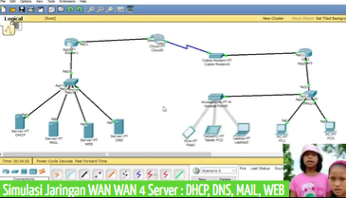
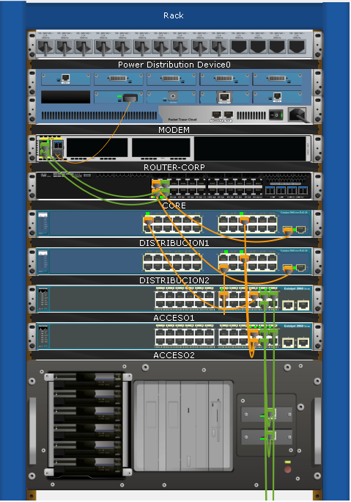
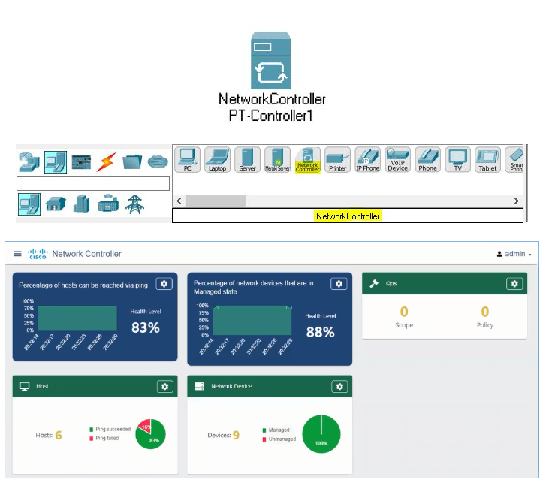
Jaringan WAN 4 Server DNS, WEB, MAIL, DHCP - Cisco Packet Tracer

Slide 4



https://github.com/siagianp
https://www.youtube.com/@AmelOline/videos
https://github.com/amelcharolinesgn2/IoT_simulator-mqtt-NodeRed
https://github.com/amelcharolinesgn2/Cloud-Infrastructures
https://github.com/amelcharolinesgn2/ClouD-Infrastructure-SISKA-2025
https://github.com/amelcharolinesgn2/Gyroscope-Sensor-Data-Accelerometer

